Slide 1


CampusSync AI
Smart College Event Hub
Prepared By:
Name : Masrani Kasak Atulbhai
Roll No : 06
Enrollment No : 23002170110083
Batch : A1
Branch : CE

Slide 2
Agenda
Unveiling CampusSync AI
01
02
Introduction
Architecture
Purpose & Vision
Technology & Systems
03
04
Key Features
AI at Core
User-Centric Design
Predictive Insights
05
06
Impact
Conclusion
Future Growth
Driving Engagement

Slide 3
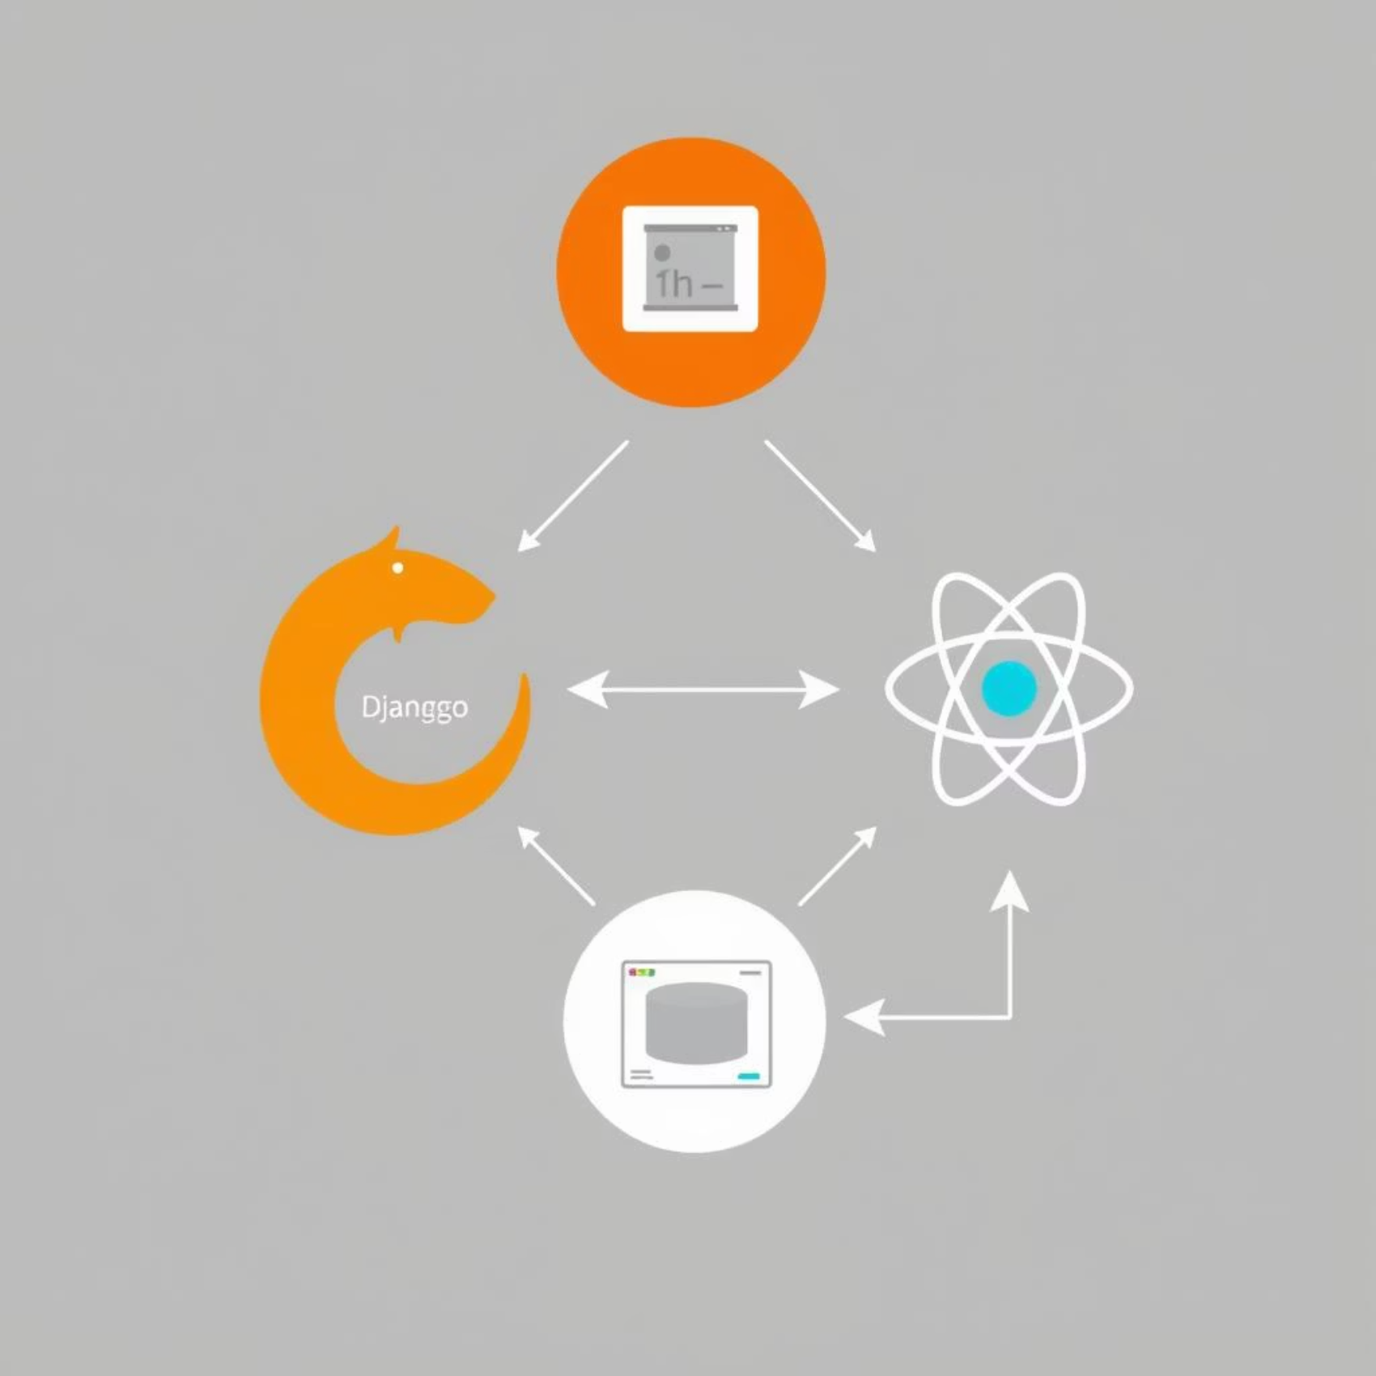
CampusSync AI
Architectural Foundation
CampusSync AI is built on a robust and scalable architecture, designed to handle diverse campus needs while leveraging cutting-edge AI capabilities. Our hybrid approach ensures both flexibility and performance.
Backend: Django — Robust & Secure
Frontend: React — Dynamic & Responsive
ML Models: Python for predictive analytics.

Slide 4




CampusSync AI
Core Features for Enhanced Engagement
Event Creation & Management
Seamless Registration
Intuitive tools for organizers to effortlessly plan, schedule, and promote events, from small study groups to large campus festivals. Create, edit and delete events.
Streamlined student sign-up processes, integrated with forgot password and reset password. Role based user registration.
Personalized Student/Organizer Dashboard
AI-Driven Recommendations
A centralized hub for students to view their registered events, to give feedback, find students of similar interests and find future events.
Leveraging machine learning to predict success rate of events and connect students with peers. Providing organizers to retrain models based on latest updates.

Slide 5

CampusSync AI
Intelligent Prediction & Connection
Predicting Event Success
Student Similarity Engine
Our AI analyzes historical data, and event characteristics to provide organizers with predictive insights into potential turnout and engagement, allowing for strategic adjustments and resource allocation. This maximizes the impact of campus initiatives.
For students, CampusSync AI suggests other students with similar interests, facilitating organic connections and enhancing social integration on campus.

Slide 6



CampusSync AI
Impact & Future Potential
Enhanced Student Life
Empowered Organizers
Optimized University Operations
Increased engagement, stronger community bonds, and personalized campus experiences.
Data-driven decisions, optimized event planning, and maximized reach for campus initiatives.
Improved resource allocation, better understanding of student needs, and a more vibrant campus.
CampusSync AI: The future of intelligent campus engagement starts now.

Slide 7
Thank you!

